Slide 1
AndroSec Toolkit (Batch – 5)
Project Guide:
Dr. Sindhu S
Students:
1. Adharsh M
2. Hari Govind K

Slide 2
Outline
Introduction
Problem Identification
Overview of AndroSec Toolkit
Timeline
References

Slide 3
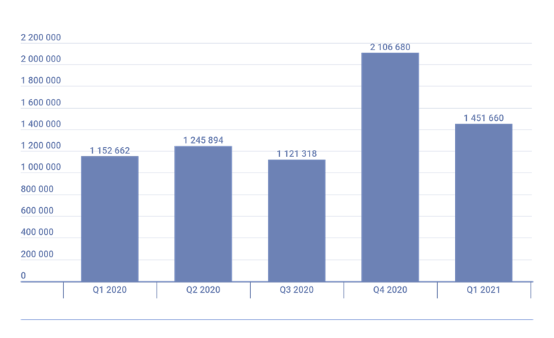
Introduction
Number of detected malicious installation packages, Q1 2020 — 2021 according to Kaspersky Security Network^{[1]}

Slide 4
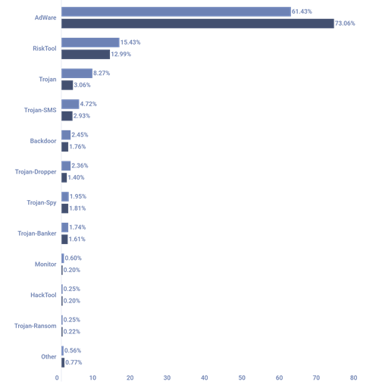
Introduction
Types of Malware^{[2]}:
Banking Malware
Mobile Ransomware
Mobile Spyware
MMS Malware
Mobile Adware
SMS Trojans

Slide 5
Problem Identification
Standalone static and dynamic analysis tools using machine learning
Signature verification using Google Play Store
VirusTotal, and other Anti-Virus vendors through malicious signature comparison
Application security analysis based on certificates and permissions

Slide 6
Problem Identification
Scan a single application and not the entire device
Need for network monitoring and analysis
Adware and content-providers leaking data
Inputs provided over a Command Line Interface (CLI)
Android Package (APK) analysis following a tedious upload process

Slide 7
AndroSec Toolkit

Slide 8
Overview
AndroSec Toolkit (GUI)
Automated Security Scan
Static Analysis
Dynamic Analysis
Network Monitoring
Identify Data-leakage
Blacklisted IPs
SIEM
Reporting and Documentation

Slide 9
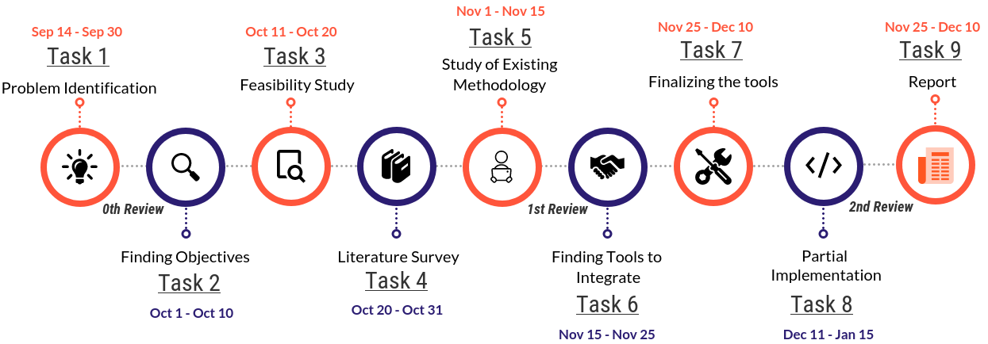
Timeline

Slide 10
Major References
Chuck Easttom, Willie Sanders, “On the Efficacy of Using Android Debugging Bridge for Android Device Forensics”, in Proc. of IEEE 10th Annual Ubiquitous Computing, Electronics & Mobile Communication Conference (UEMCON), 2019
Benfano Soewito, Agung Suwandaru, “Android sensitive data leakage prevention with rooting detection using Java function hooking”, Journal of King Saud University - Computer and Information Sciences,2020 (in press)
Thomas Cory, Philip Raschke, Axel Küpper, “Heimdall: Illuminating the Hidden Depths of Third-Party Tracking in Android Applications”, in Proc. of IEEE 19th International Conference on Trust, Security and Privacy in Computing and Communications (TrustCom), 2021

